Slide 1
AI Powered Online Assessment Proctoring System
Guided By
Mrs. R. Rajeshwari M.C.A, M.Phil, (Ph.D)
Santhosh K
111923MC02043

Slide 2
AI Powered Online Assessment Proctoring System
Guided By
Mrs. R. Rajeshwari M.C.A, M.Phil, (Ph.D)
Santhosh K
111923MC02043

Slide 3
SYNOPSIS
ABSTRACT
INTRODUCTION
EXISTING SYSTEM
PROPOSED SYSTEM
SOFTWARE REQUIREMENTS
HARDWARE REQUIREMENTS
DFD
ER DIAGRAM
CONTEXT ANALYSIS
MODULAR DESCRIPTION
DATA DICTIONARY
SCREENSHOTS
MERITS
LIMITATIONS
FUTURE ENHANCEMENTS
CONCLUSION

Slide 4
ABSTRACT
The AI-Powered Online Assessment Proctoring System is a cutting-edge solution designed to enhance the integrity and security of online examinations.
This system replaces traditional safe browsers with advanced AI-driven proctoring mechanisms, ensuring a seamless and secure testing environment for students, teachers, and administrators.
By integrating real-time face detection, behavior analysis, and environment monitoring, the system identifies and flags suspicious activities, mitigating the risks of cheating.
It features a robust role-based access structure, enabling administrators to manage users, teachers to create and monitor quizzes, and students to participate securely.
The platform leverages the MERN stack for scalability and performance, while AI algorithms ensure efficient proctoring without the need for extensive human intervention.

Slide 5
INTRODUCTION
The rapid shift toward online learning and assessment has underscored the need for secure, reliable, and scalable examination systems.
Traditional safe browsers, while effective to an extent, often fall short in addressing sophisticated challenges like unauthorized access, impersonation, or cheating.
This system leverages advanced technologies such as AI-based face detection, behavior analysis, and environment monitoring to provide robust proctoring capabilities.
By detecting and flagging suspicious activities in real time, it eliminates the need for continuous human oversight while ensuring a seamless examination experience for students.
It includes role-based functionalities to cater to administrators, teachers, and students.
Teachers can create and share quizzes, students can participate with confidence in a secure environment, and administrators can manage operations effortlessly.

Slide 6
EXISTING SYSTEM
The current assessment systems primarily include paper-based exams, non-proctored online exams, and proctored online exams using safe browsers or manual monitoring.
Paper-based exams rely on physical distribution of question papers and manual invigilation, offering direct interaction but facing logistical challenges, environmental concerns, and limited scalability.
Non-proctored online exams allow students to take tests conveniently from their devices but are prone to cheating and lack credibility.
Proctored online exams using safe browsers improve security by restricting access to external resources but fail to address sophisticated cheating methods, cause dependency on specific environments, and often inconvenience users with restrictive measures.
These systems exhibit significant limitations in ensuring integrity, scalability, and adaptability in modern education.

Slide 7
DISADVANTAGES
Logistical challenges in paper-based exams.
Environmental concerns of paper-based exams.
High cheating potential in non-proctored exams.
Lack of monitoring mechanisms in non-proctored exams.
Limited sophistication and flexibility of safe browsers.
Intrusive and restrictive nature of safe browsers.

Slide 8
PROPOSED SYSTEM
The AI-Powered Online Assessment Proctoring System offers a modern and comprehensive solution to address the shortcomings of existing assessment methods.
Leveraging advanced AI technologies, this system ensures the integrity and credibility of online exams through real-time face detection, behavior analysis, and environment monitoring.
Unlike traditional systems, this solution eliminates the need for restrictive safe browsers while providing a seamless and secure experience for students, teachers, and administrators.
Built using the MERN stack, it is highly scalable, adaptable, and user-friendly. The platform supports role-based access, enabling efficient management of users, quiz creation, and monitoring.
Additionally, it prioritizes privacy with a local deployment option, ensuring data security and accessibility for educational institutions.

Slide 9
ADVANTAGES
Enhanced exam integrity through real-time monitoring.
Detection of suspicious activities using AI-based behavior analysis.
Elimination of restrictive safe browser dependencies.
Scalable and adaptable for diverse educational needs.
Role-based access for streamlined user management.
Privacy-focused with local deployment options.
User-friendly interface for teachers, students, and administrators.

Slide 10
FEATURES
Role-based login for Admin, Teacher, and Student.Admin can add/view/delete students, download test reports.
Teacher can create/edit tests with 4 question types (MCQ, True/False, Fill in the Blanks), add images, assign tests, view reports.
Student can attend tests, view/download auto-generated reports.
Real-time proctoring with toast alerts and behavior logs in reports.
Profile management with password reset option.
Forgot password via email with reset link.

Slide 11
SOFTWARE REQUIREMENTS
Operating System
Windows 10/11, Linux , or macOS.
Programming Languages
Frontend: JavaScript, React.js.
Backend: Node.js with Express.js.
Database
MongoDB.
Development Frameworks and Libraries
Frontend: Redux Toolkit, TensorFlow.js.
Backend: Express.js,TensorFlow.js.
Version Control System
Git.
Browser
Google Chrome, Mozilla Firefox.

Slide 12
HARDWARE REQUIREMENTS
Processor
Minimum: Intel Core i5 (8th Gen) or AMD Ryzen 5 equivalent.
Recommended: Intel Core i7 (10th Gen) or AMD Ryzen 7 equivalent.
RAM
Minimum: 8 GB.
Recommended: 16 GB or more.
Storage
Minimum: 256 GB SSD.
Recommended: 512 GB SSD or higher.

Slide 13
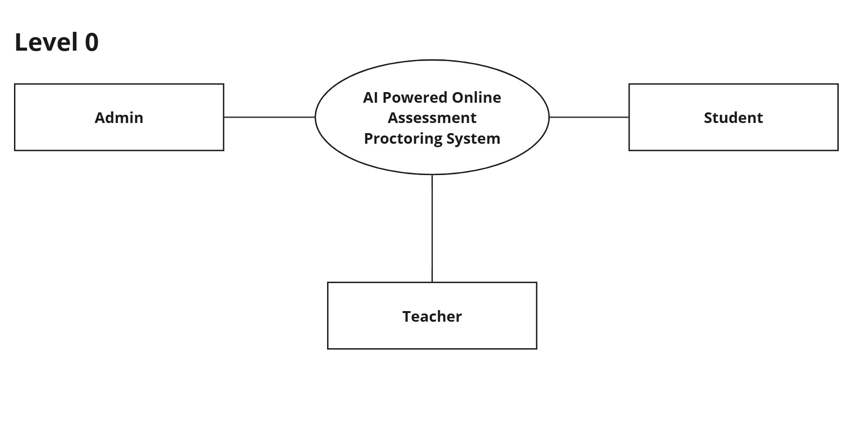
DFD Level 0

Slide 14
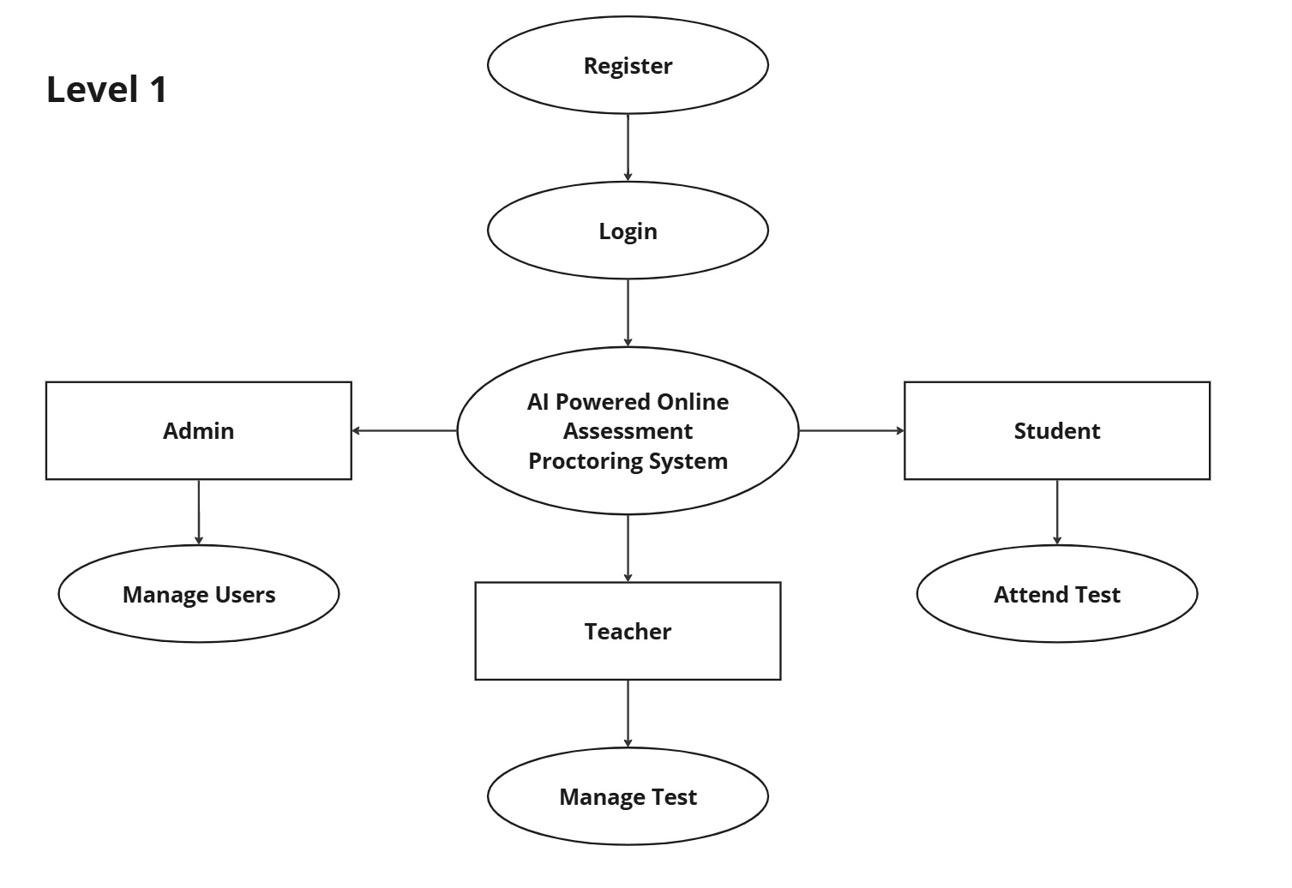
DFD Level 1

Slide 15
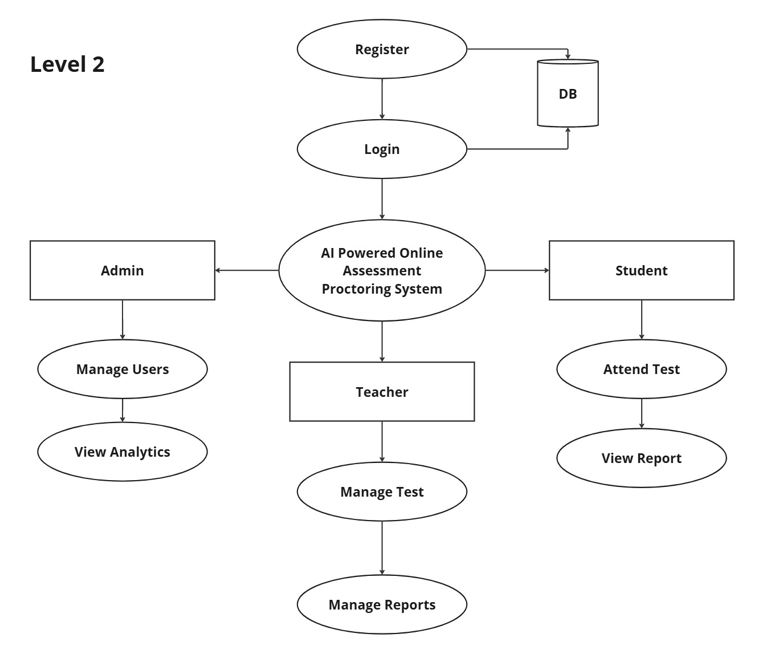
DFD Level 2

Slide 16
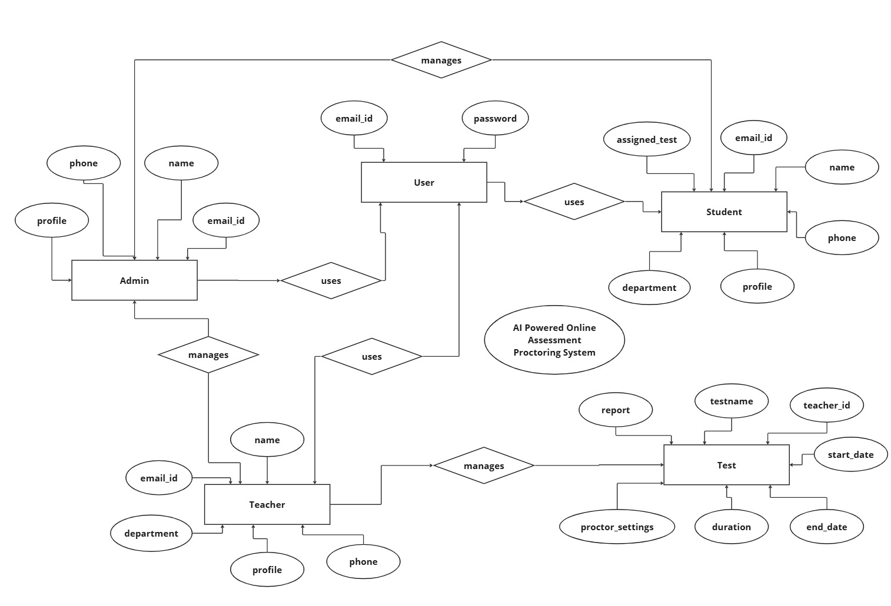
ER Diagram

Slide 17
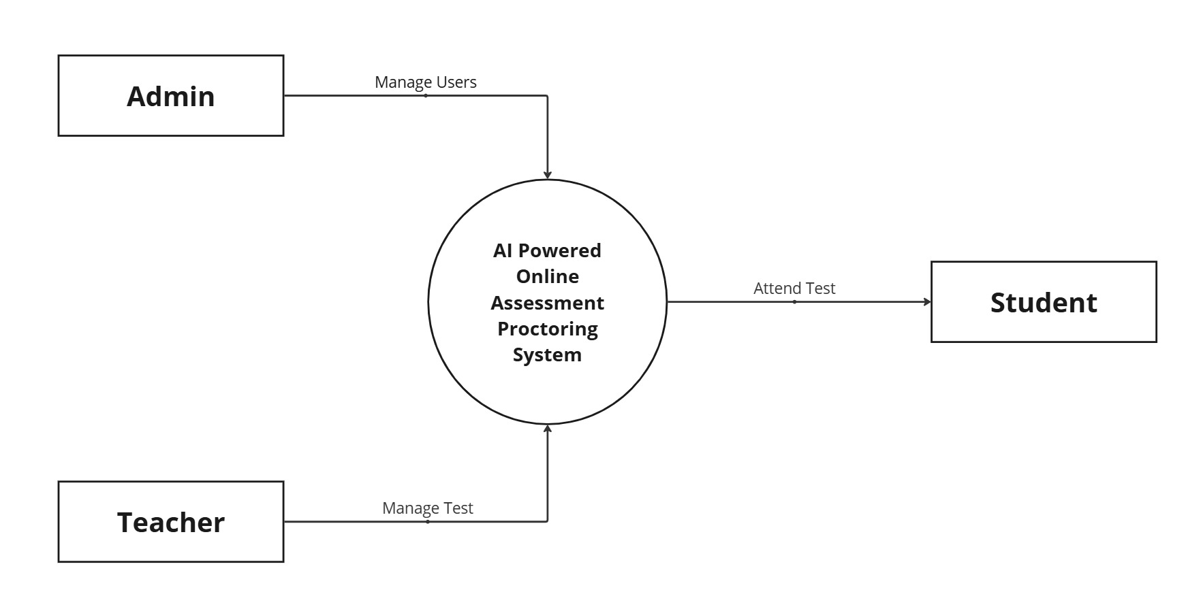
Context Analysis Diagram

Slide 18
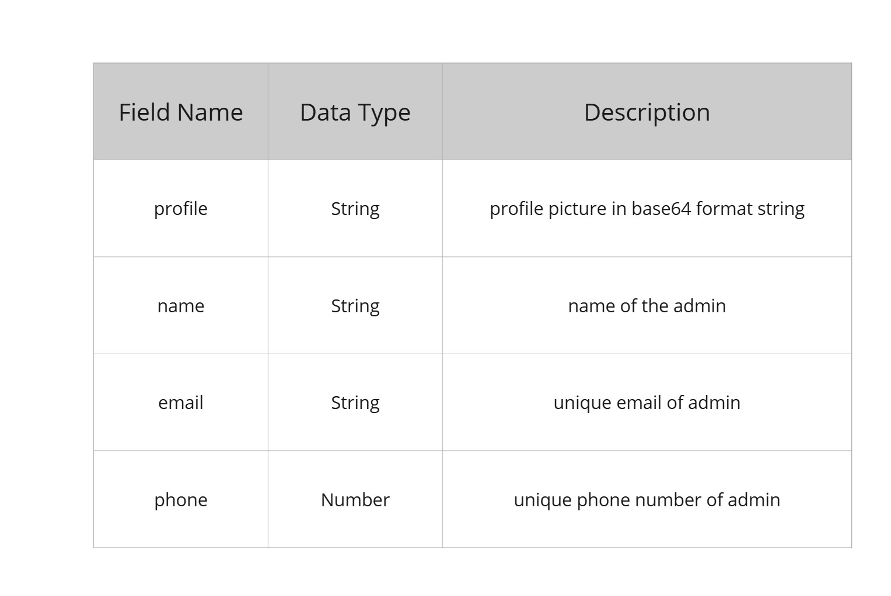
Data Dictionary - Admin

Slide 19
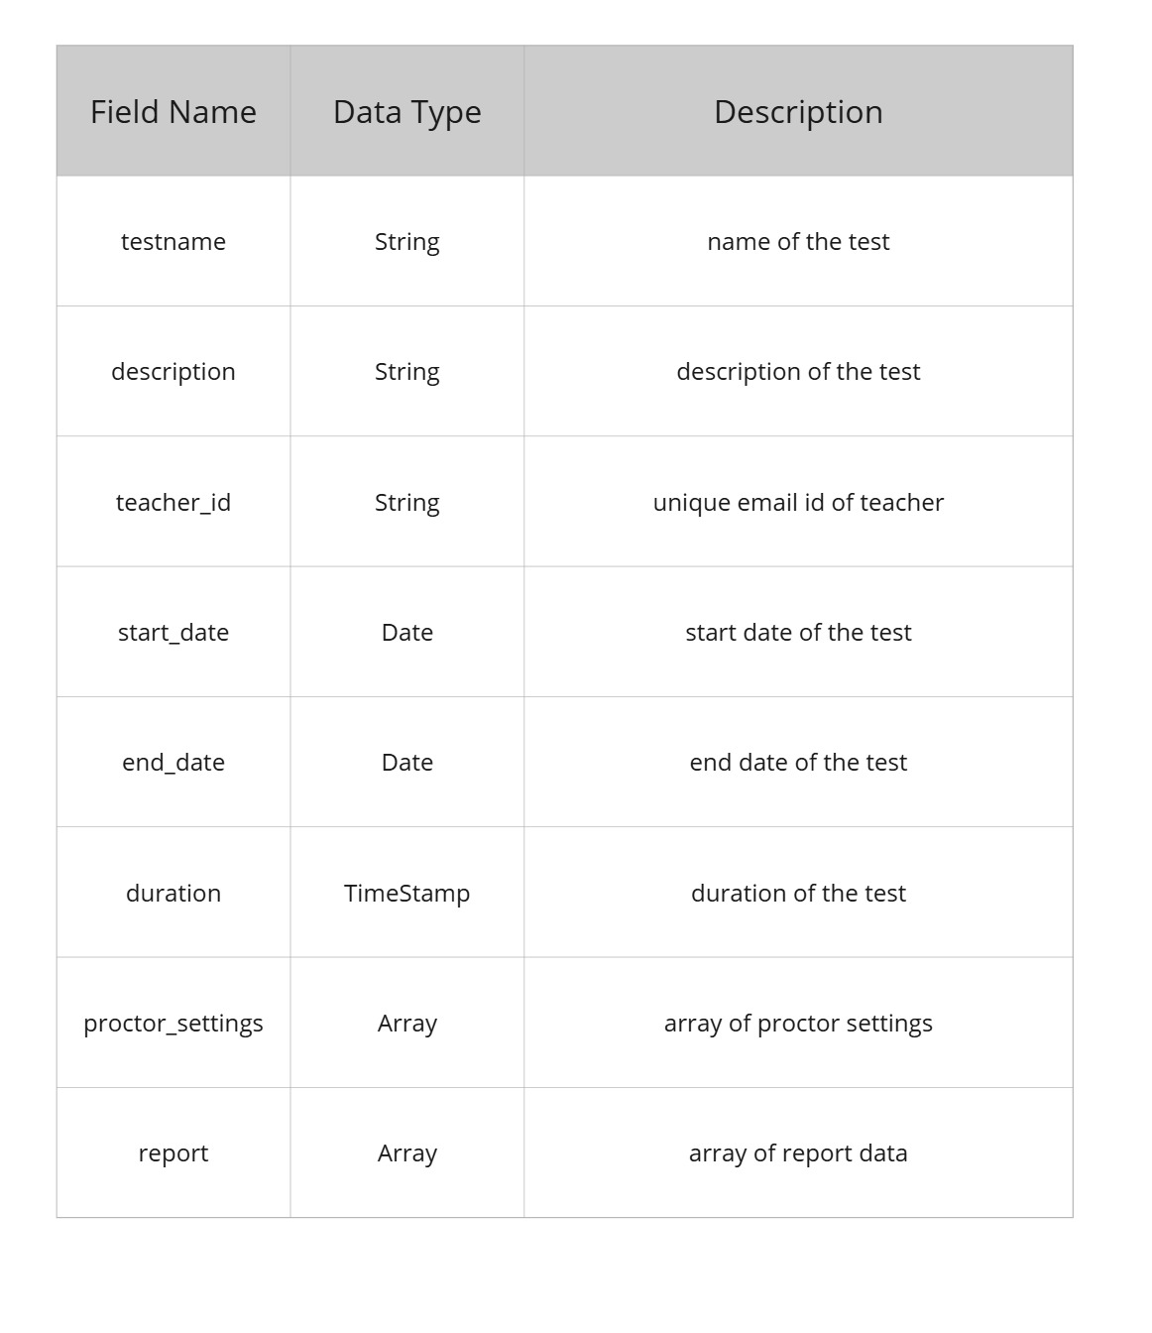
Data Dictionary - Test

Slide 20
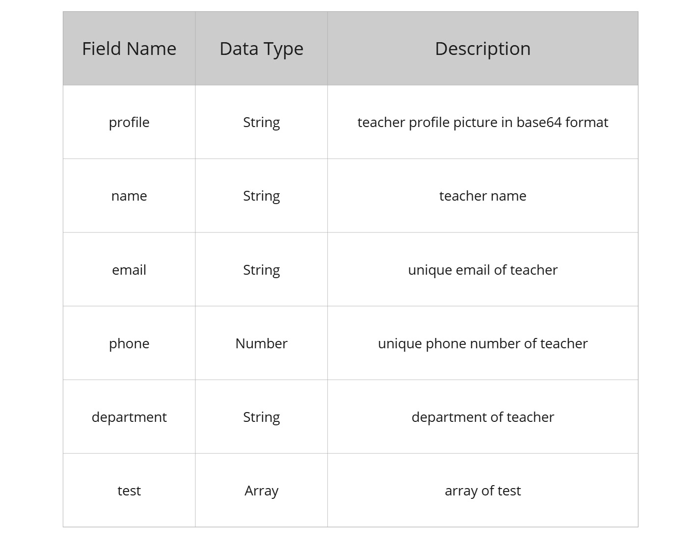
Data Dictionary - Teacher

Slide 21
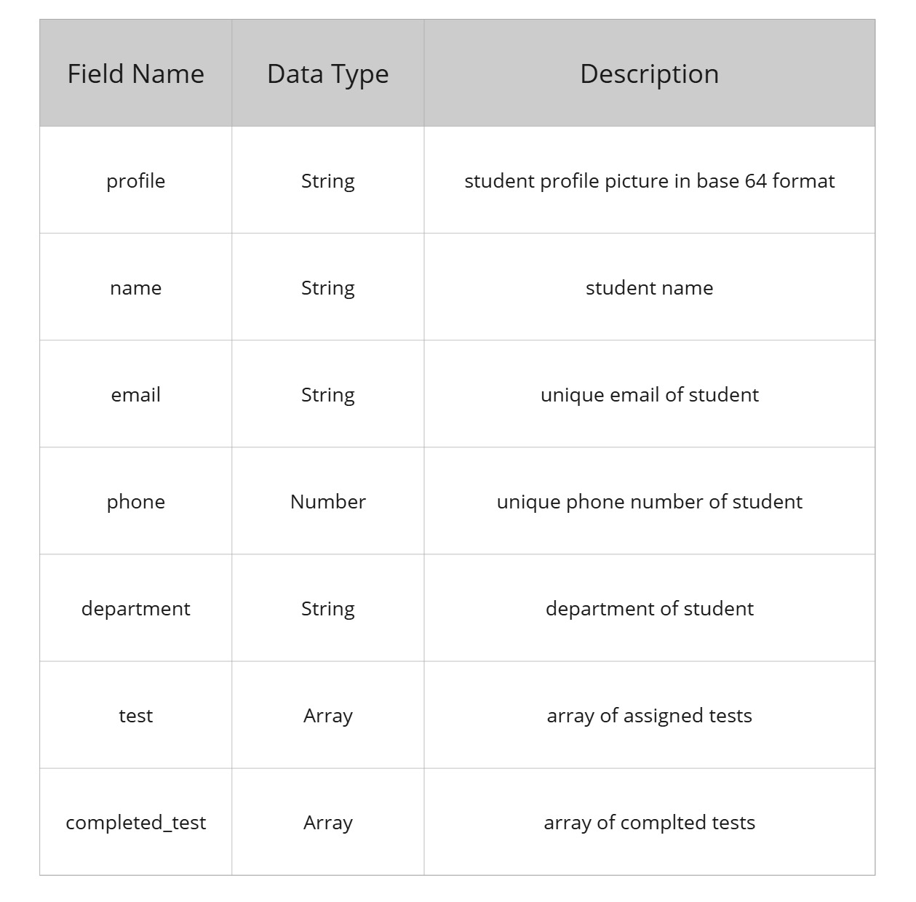
Data Dictionary - Student

Slide 22
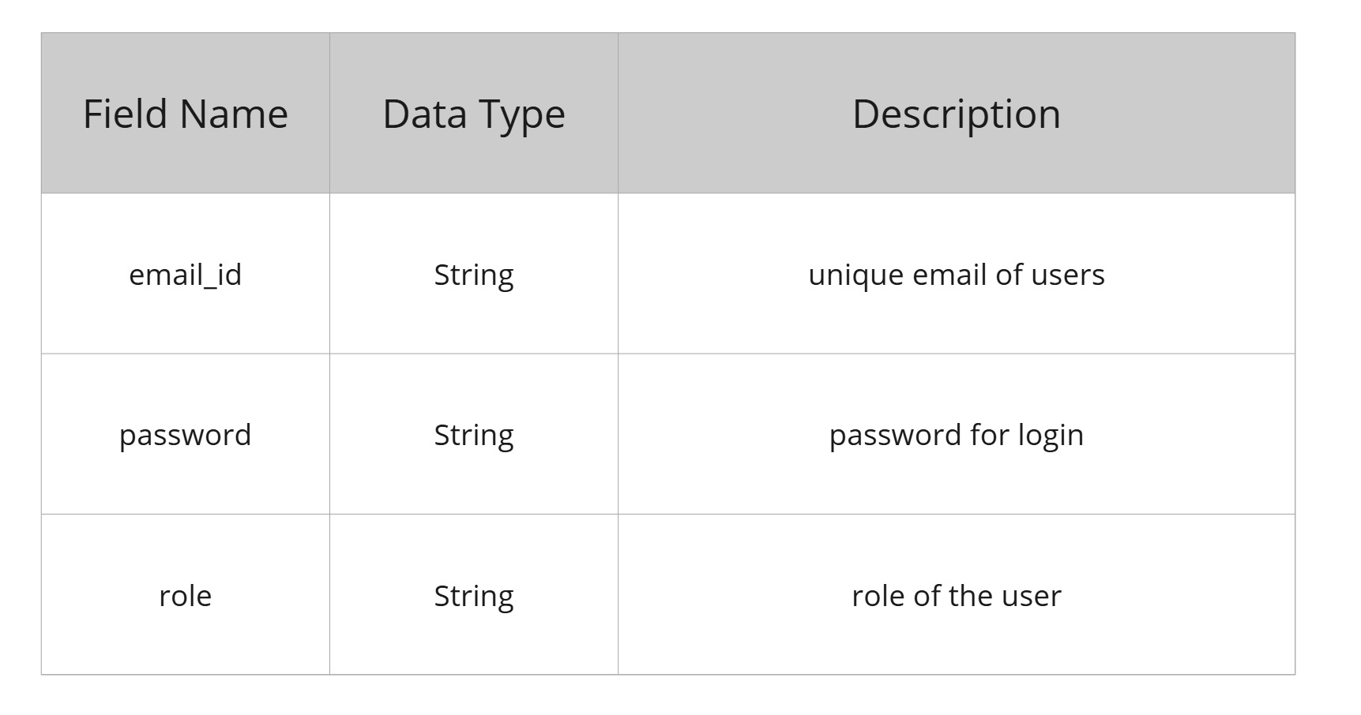
Data Dictionary - Login

Slide 23
Modular Description
1. Admin Module
The Admin has overall control of the system, managing users and settings.
User Management: Add, update, and remove teachers and students.
Quiz Monitoring: View quiz reports, logs, and flagged activities from proctoring.
Manage Teachers and Students:View, Add, Delete teachers and students and bulk upload students.

Slide 24
Modular Description
2. Teacher Module
The Teacher creates and manages quizzes for students.
Quiz Creation: Add quizzes with multiple-choice, descriptive, or coding questions.
Student Management: Assign quizzes to students and monitor their progress.
AI Proctoring Review: View flagged activities or suspicious behavior detected by AI.
Performance Analysis: Check student performance and generate reports.

Slide 25
Modular Description
3. Student Module
The Student attempts quizzes and is monitored by the AI proctoring system.
Quiz Participation: Access assigned quizzes and submit answers within deadlines.
AI Proctoring: Live monitoring via webcam, face detection, and activity tracking.
Report & Feedback: View quiz scores, feedback, and flagged activity logs.

Slide 26
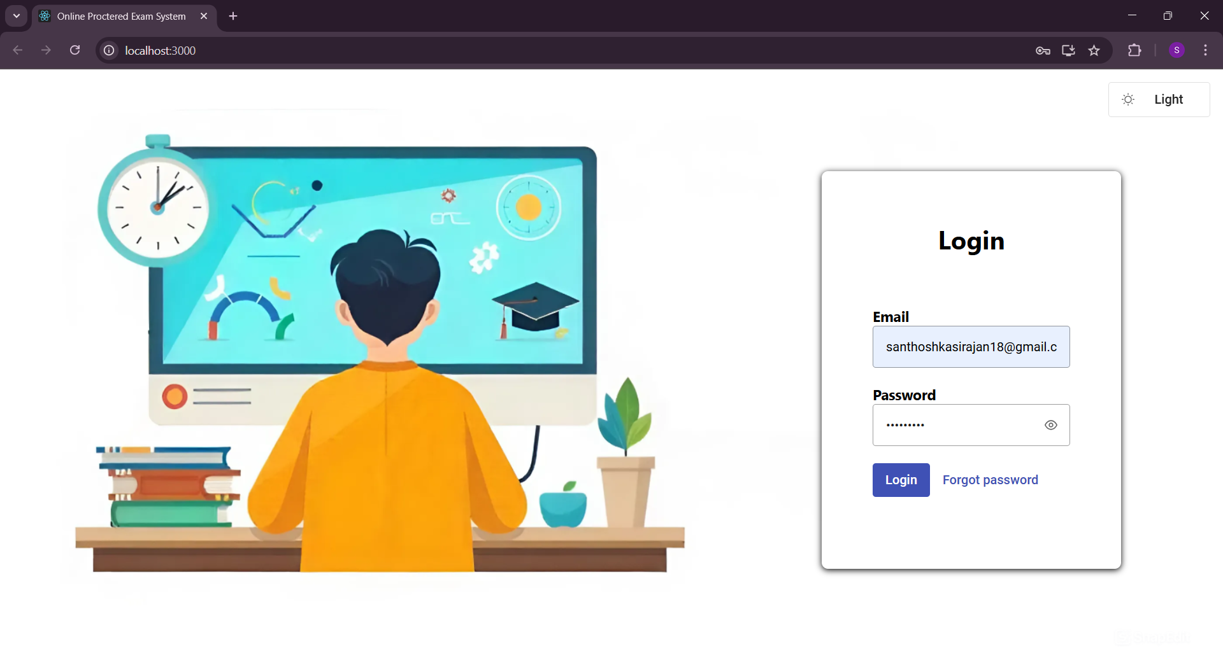
Login Page

Slide 27
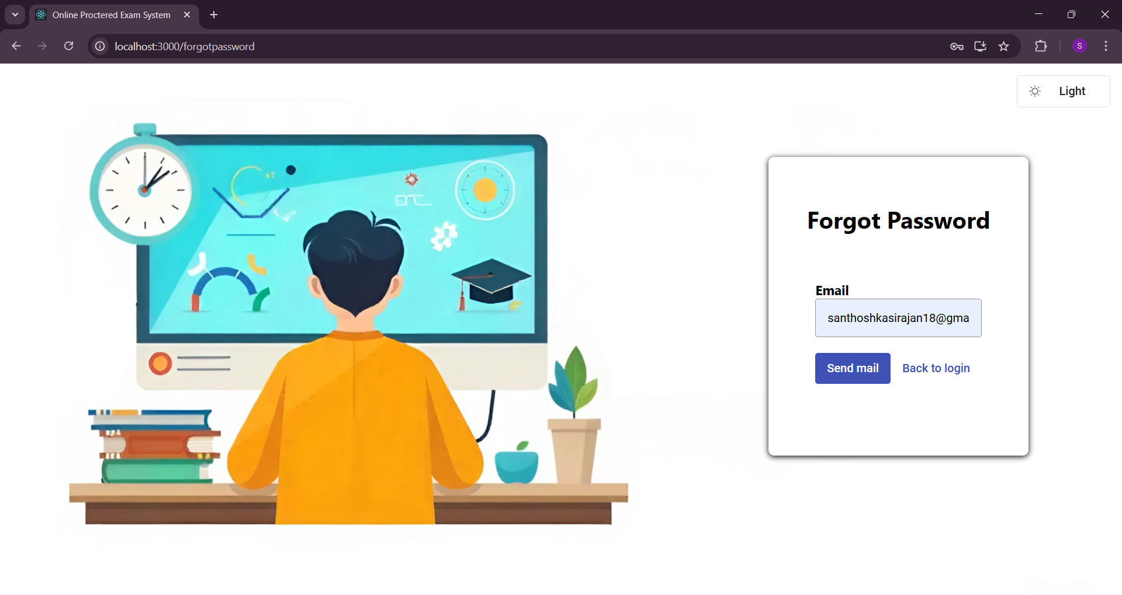
Forgot Password Page

Slide 28

Reset Password Page

Slide 29
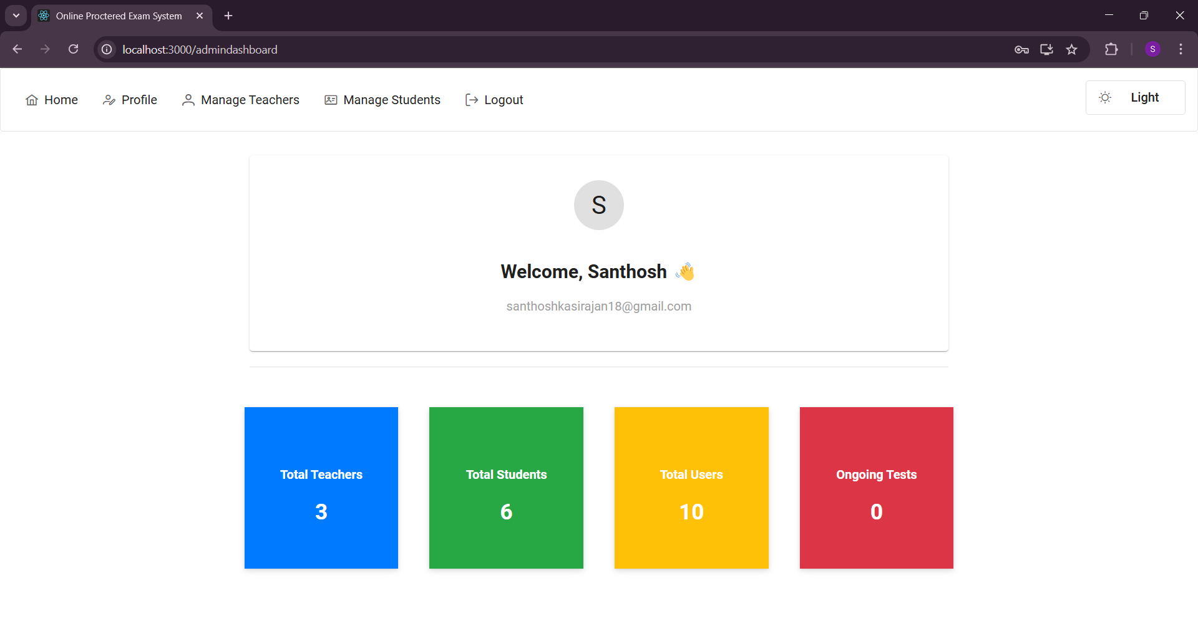
Admin Dashboard

Slide 30
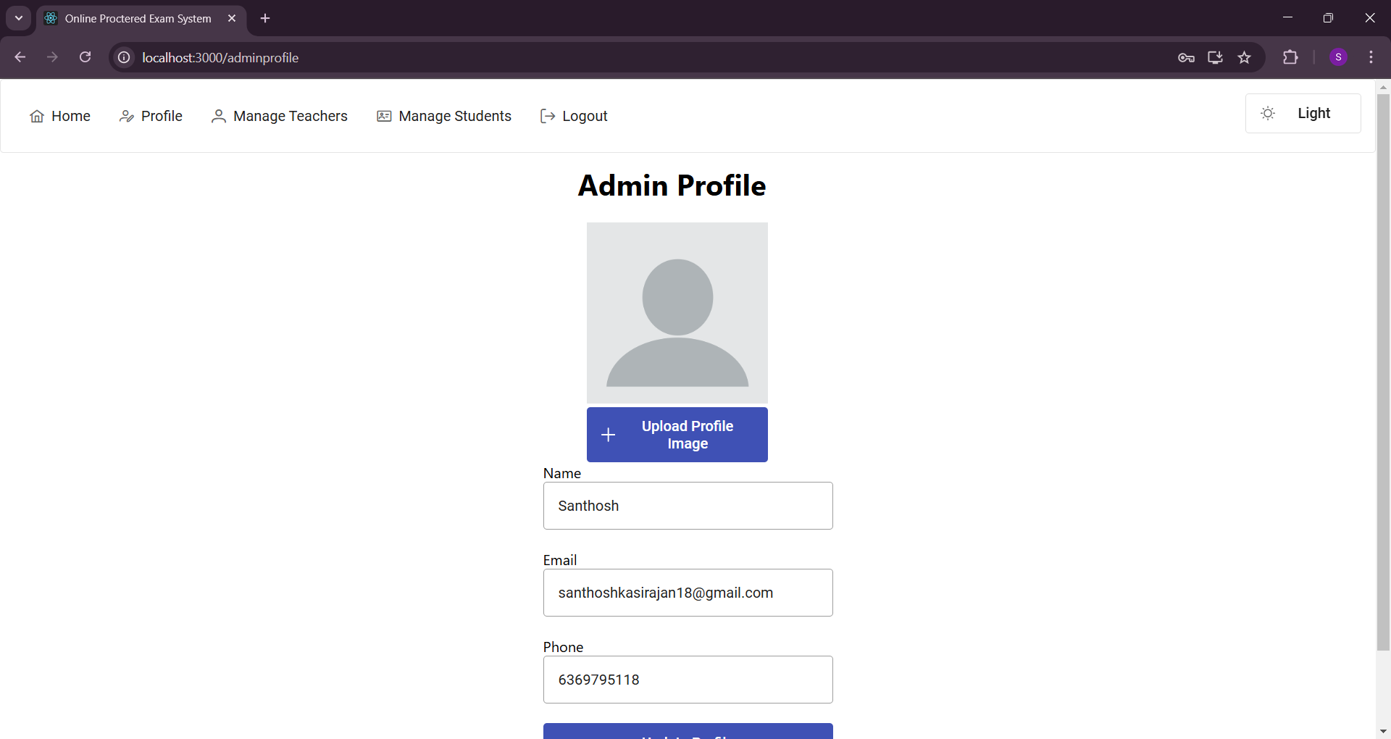
Admin Profile

Slide 31
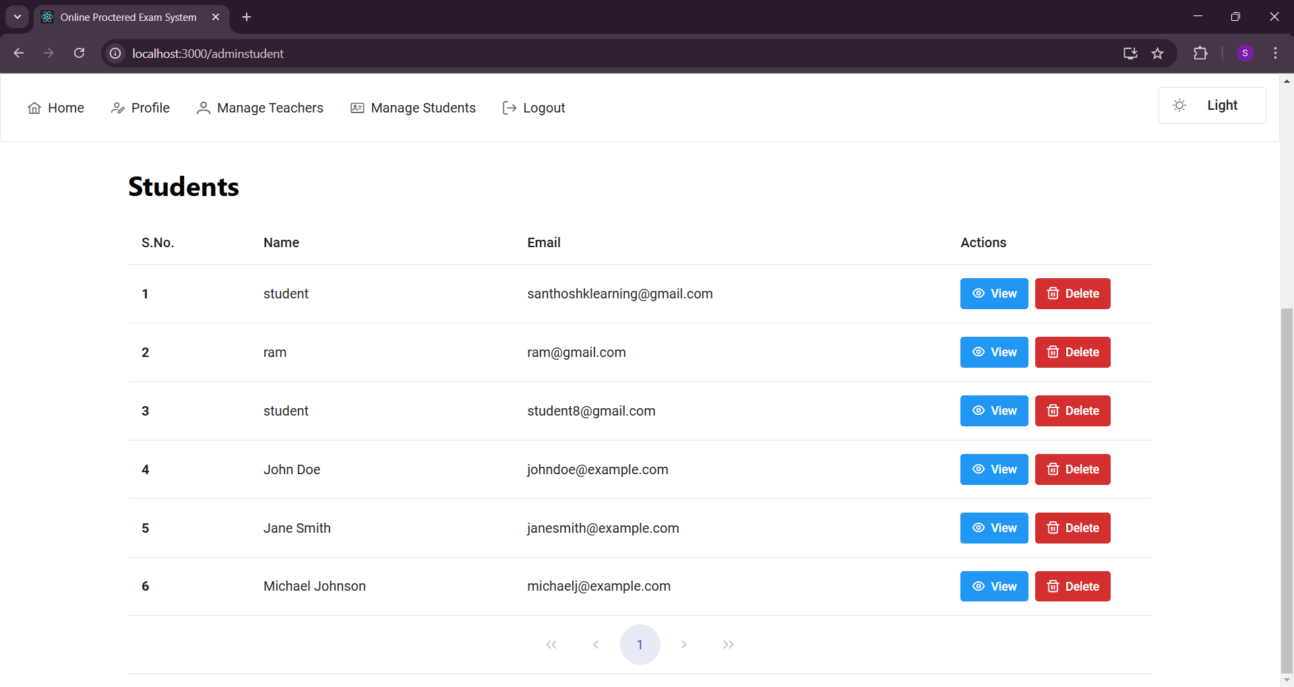
Admin Manage Student

Slide 32
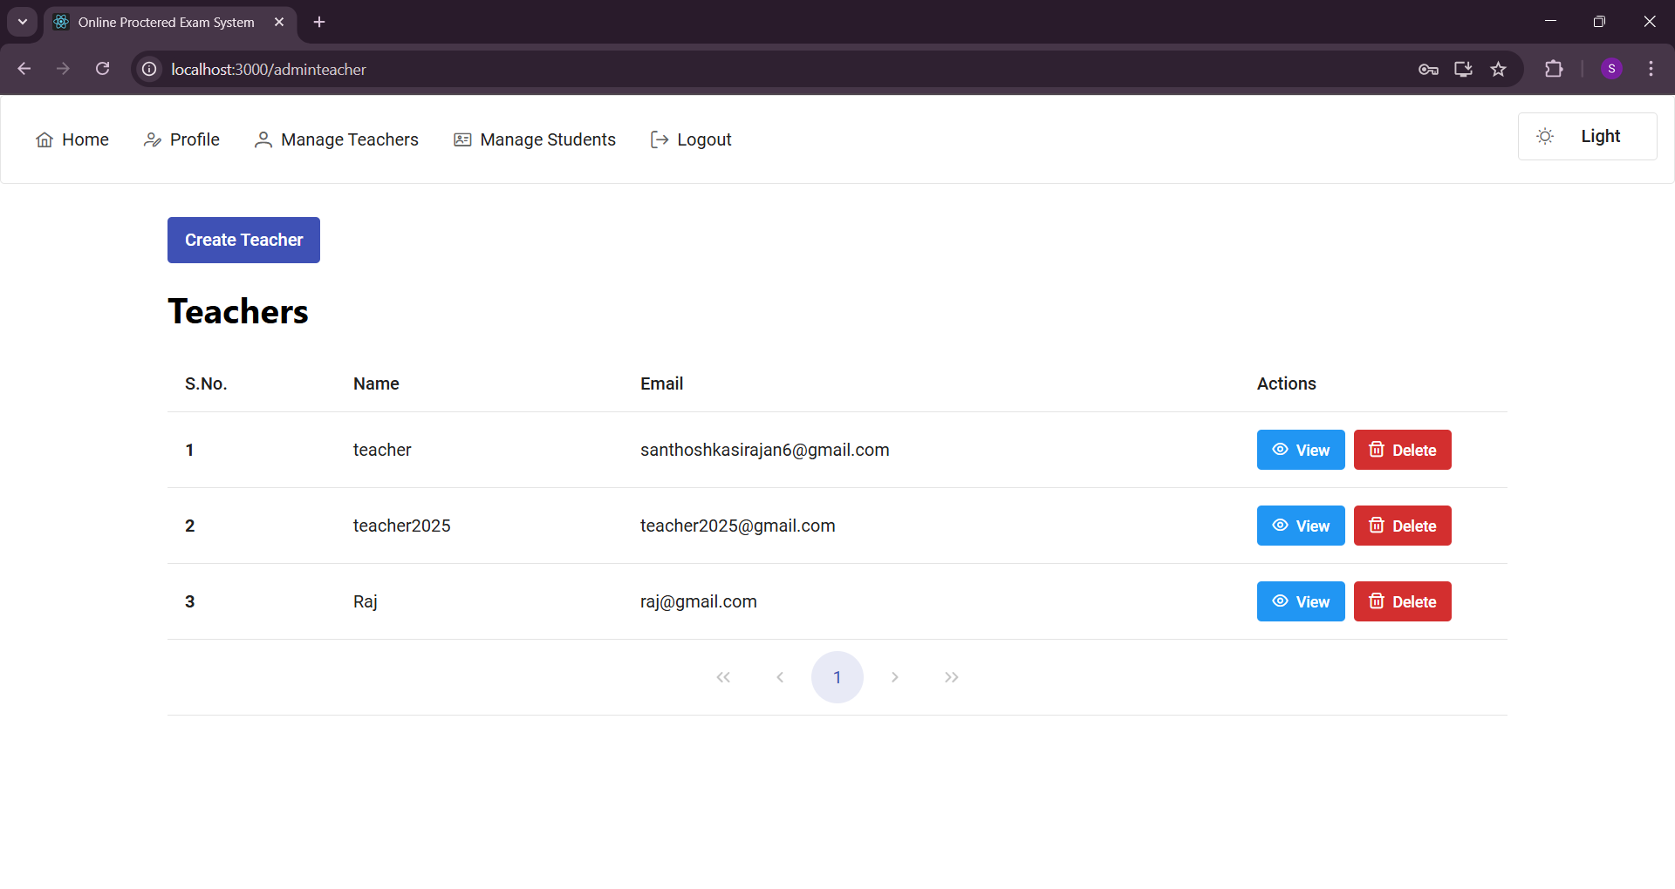
Admin Manage Teacher

Slide 33
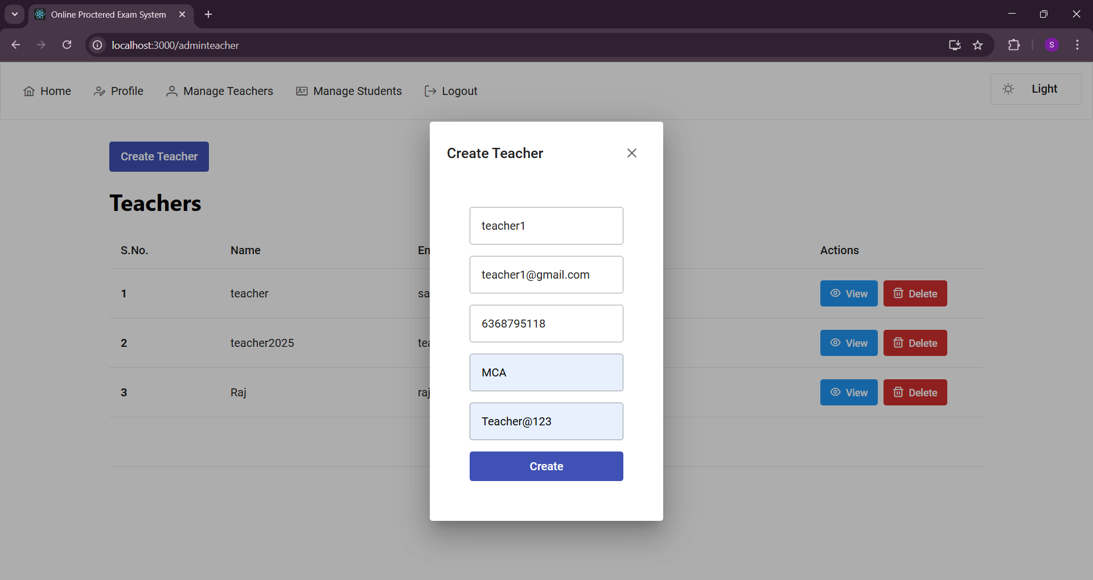
Admin Add Teacher

Slide 34
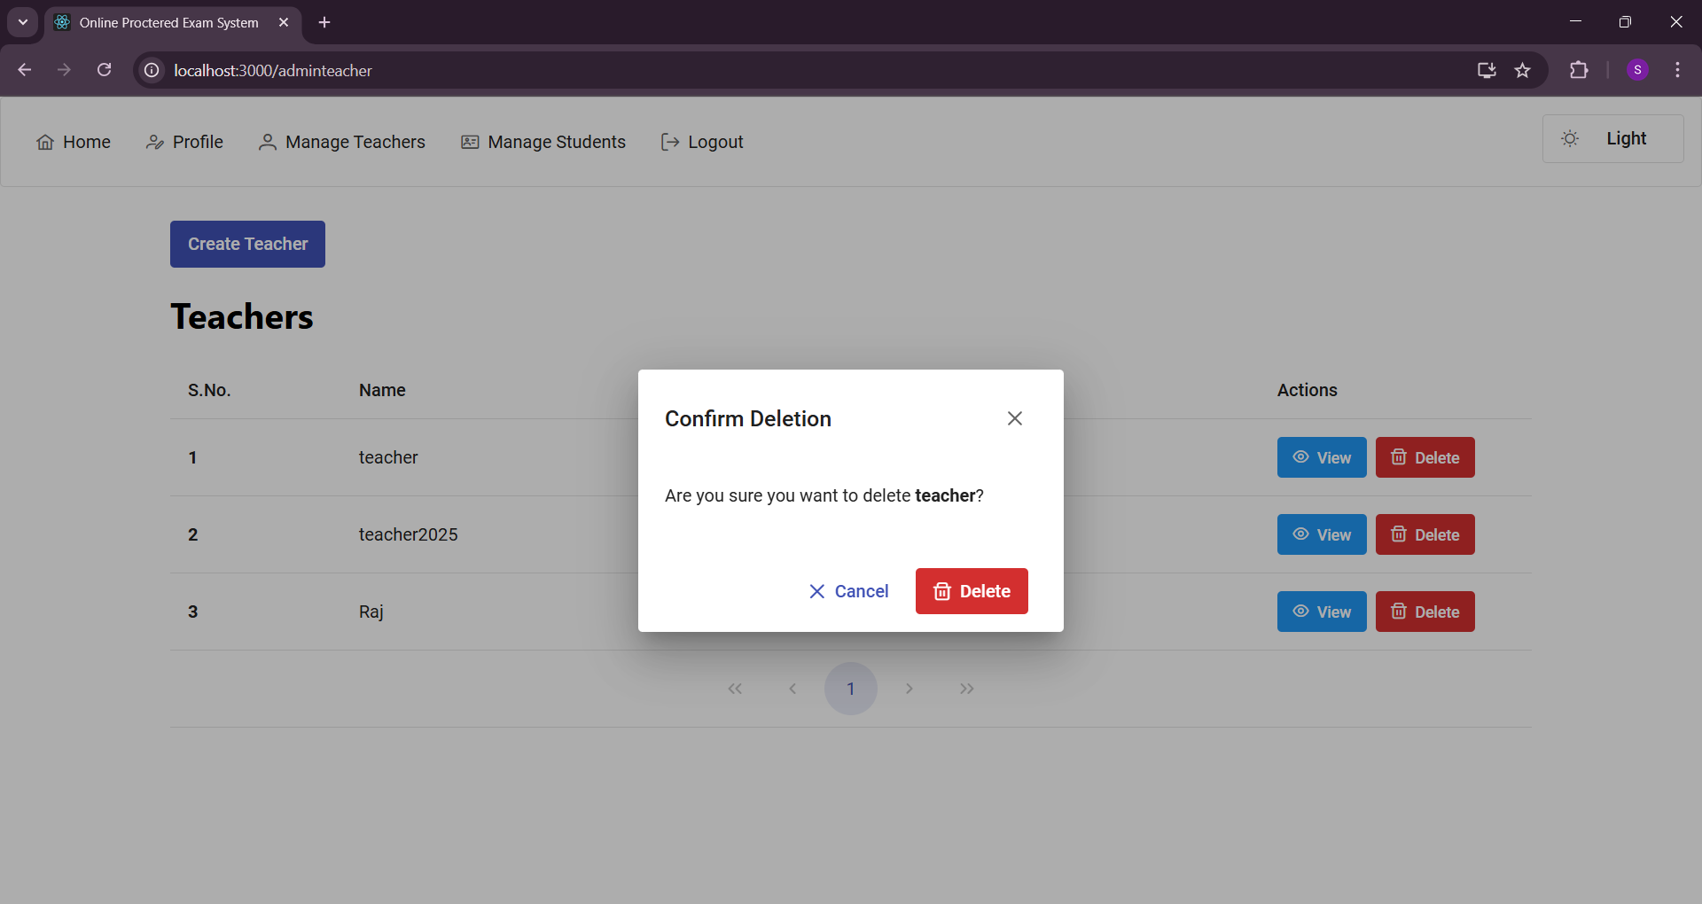
Admin Delete Teacher

Slide 35
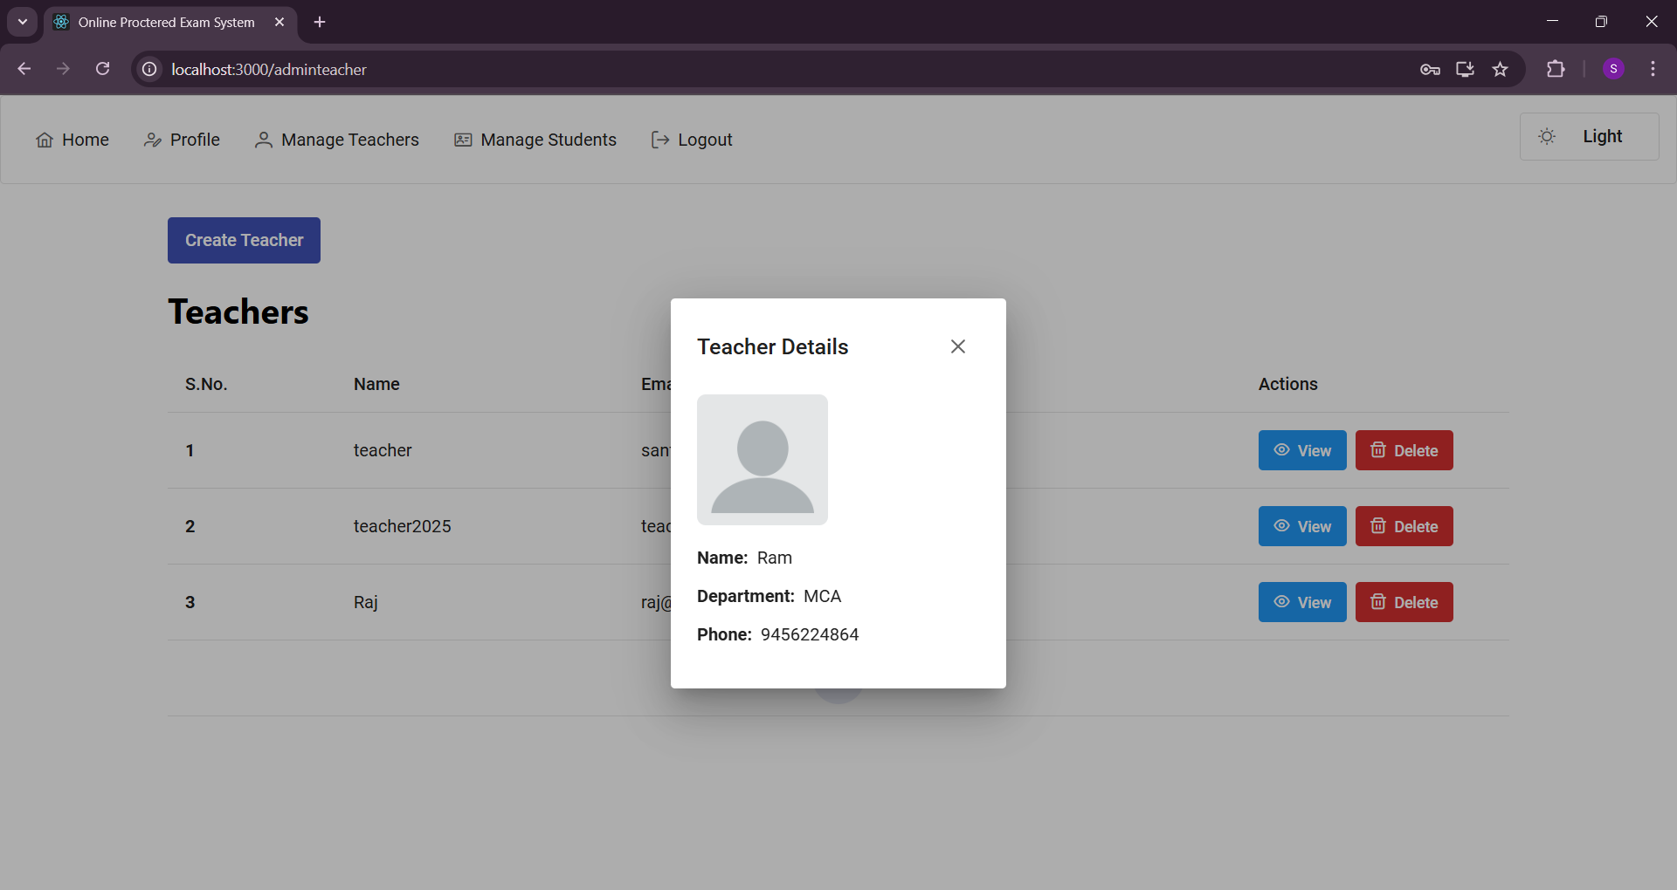
Admin View Teacher

Slide 36
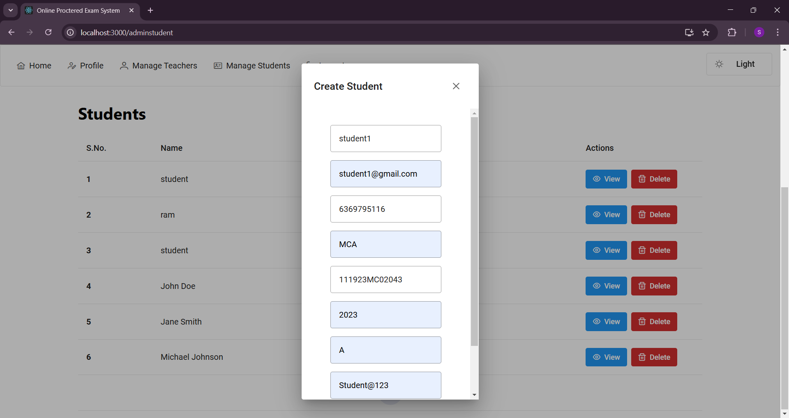
Admin Add Student

Slide 37
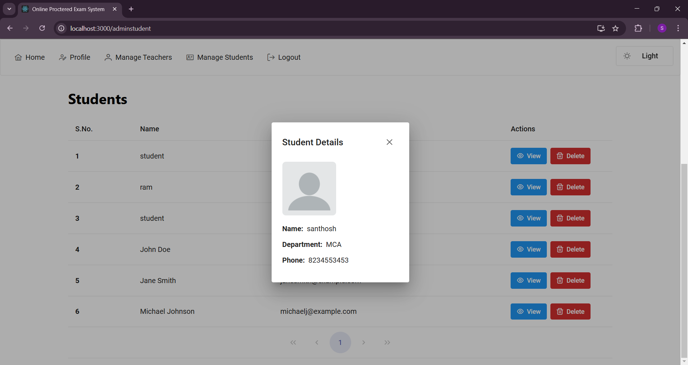
Admin View Student

Slide 38
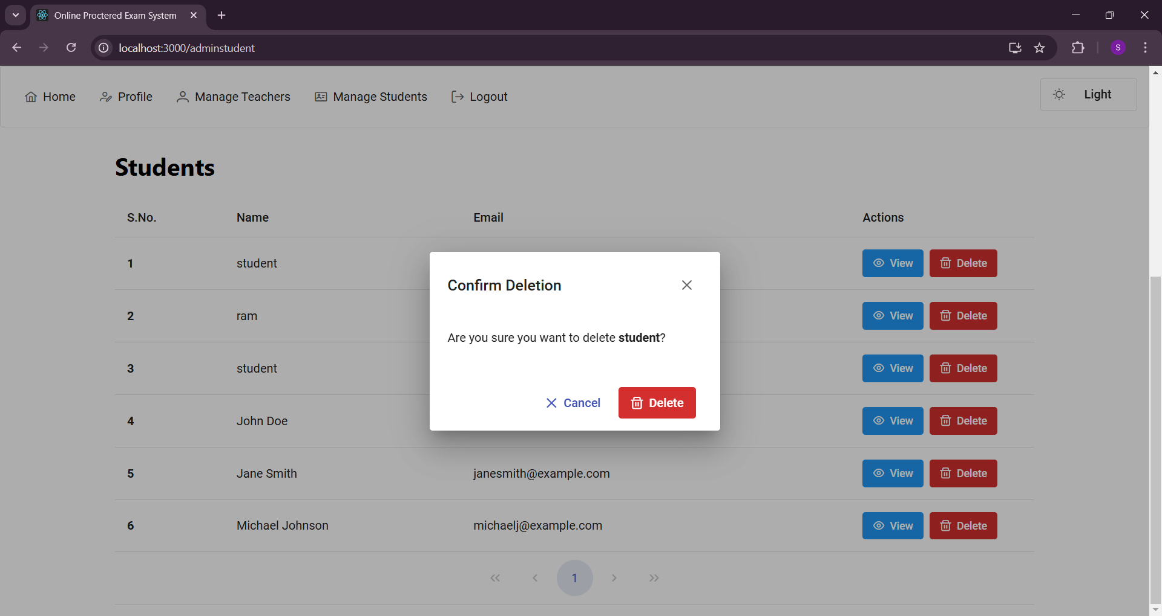
Admin Delete Student

Slide 39
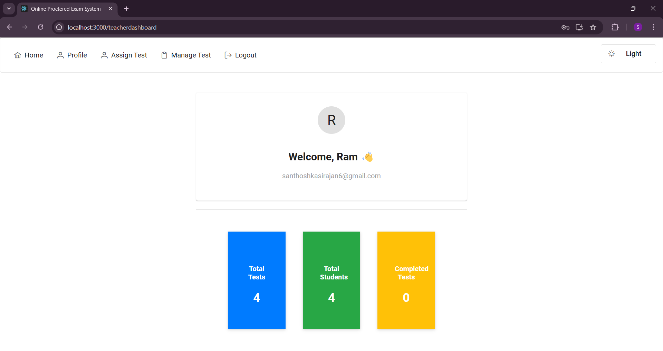
Teacher Dashboard

Slide 40
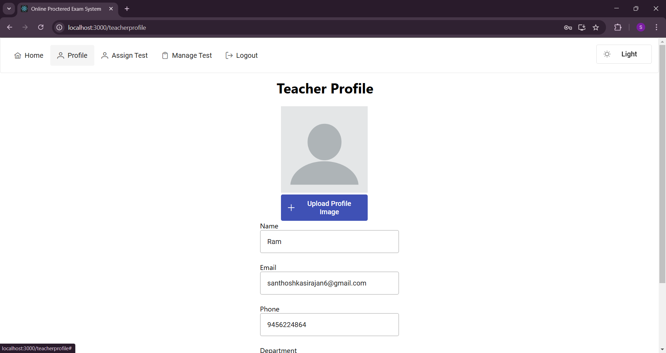
Teacher Profile

Slide 41
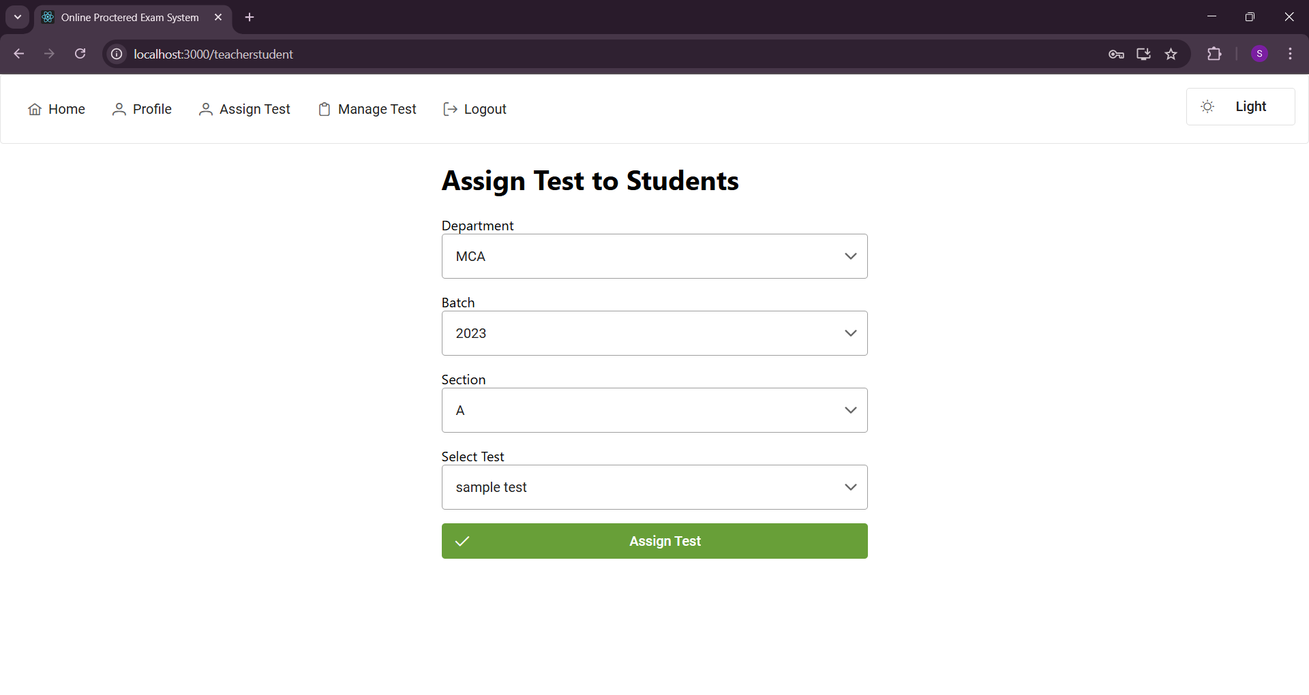
Teacher Assign Test

Slide 42
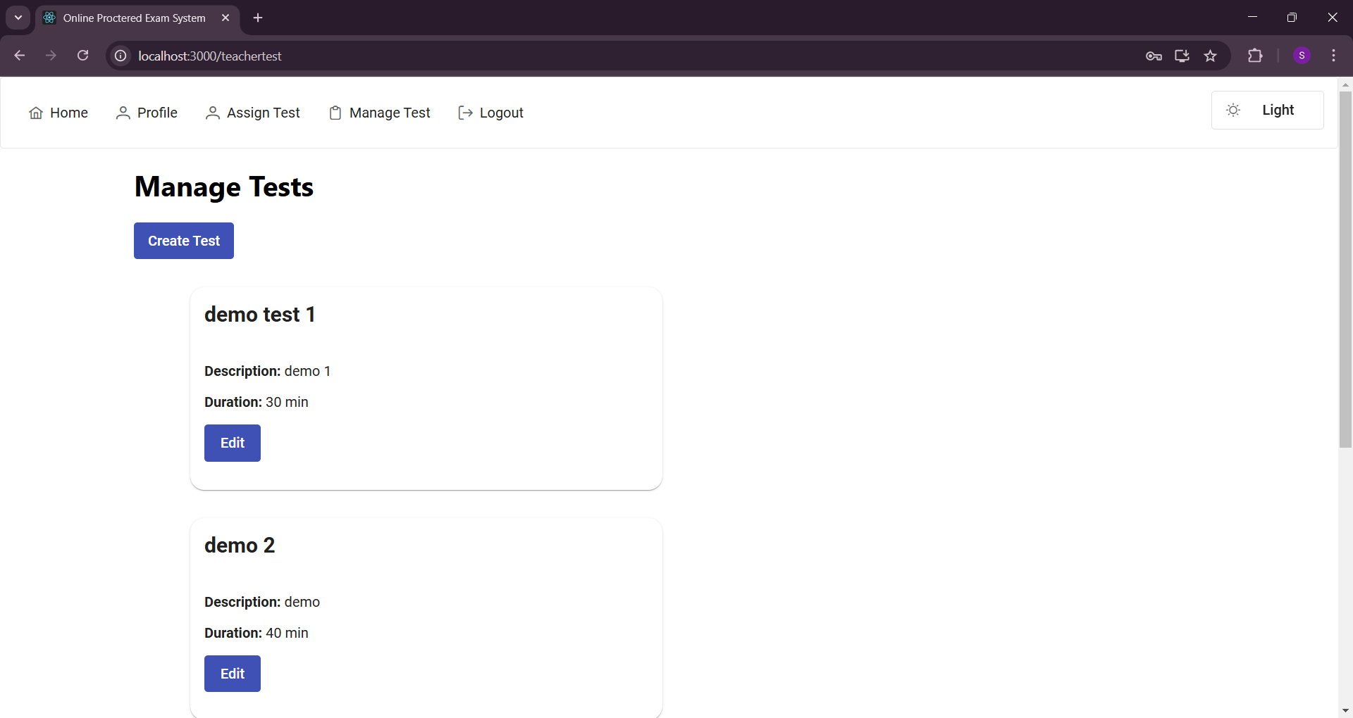
Teacher Manage Test

Slide 43
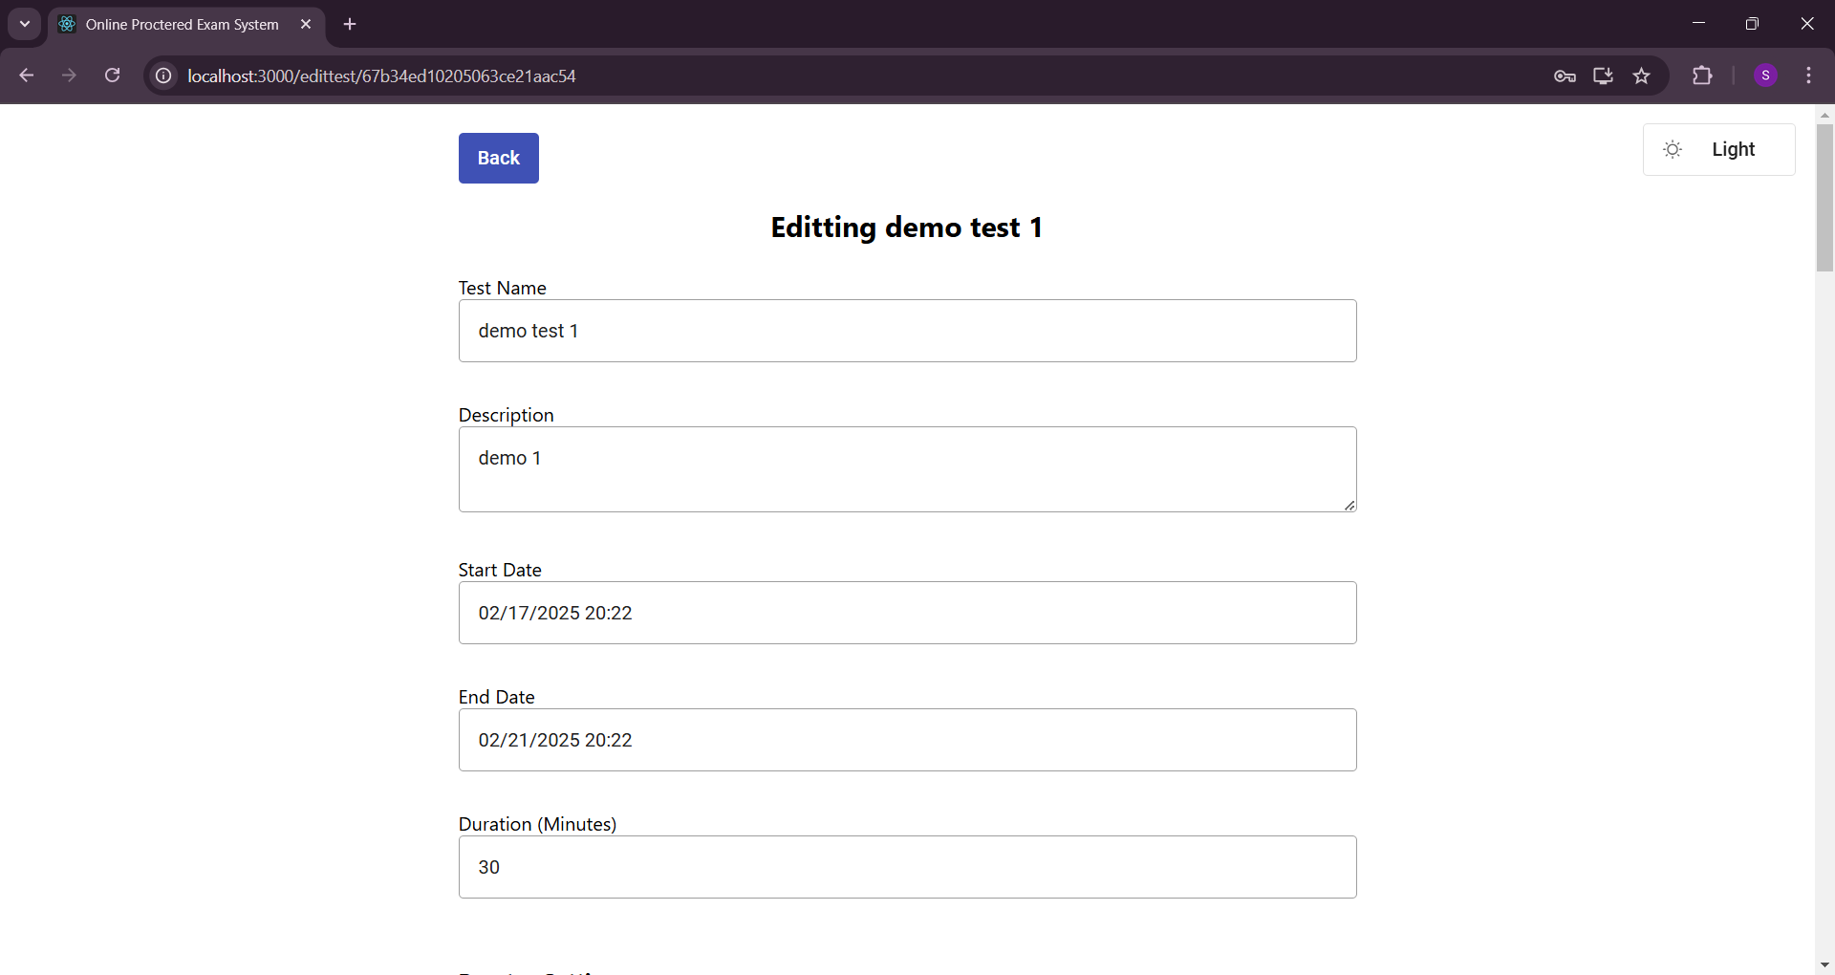
Teacher Edit Test

Slide 44
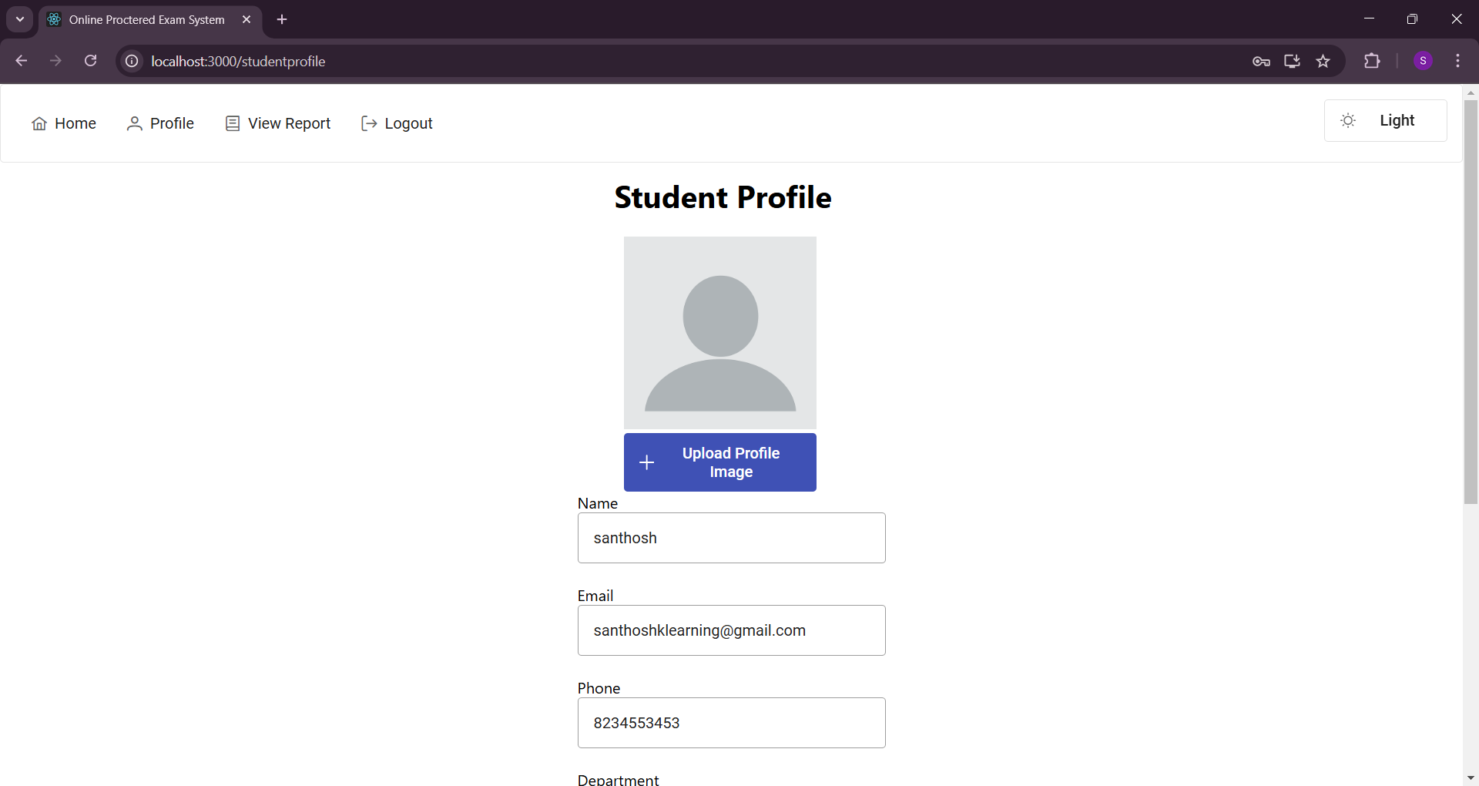
Student Profile

Slide 45
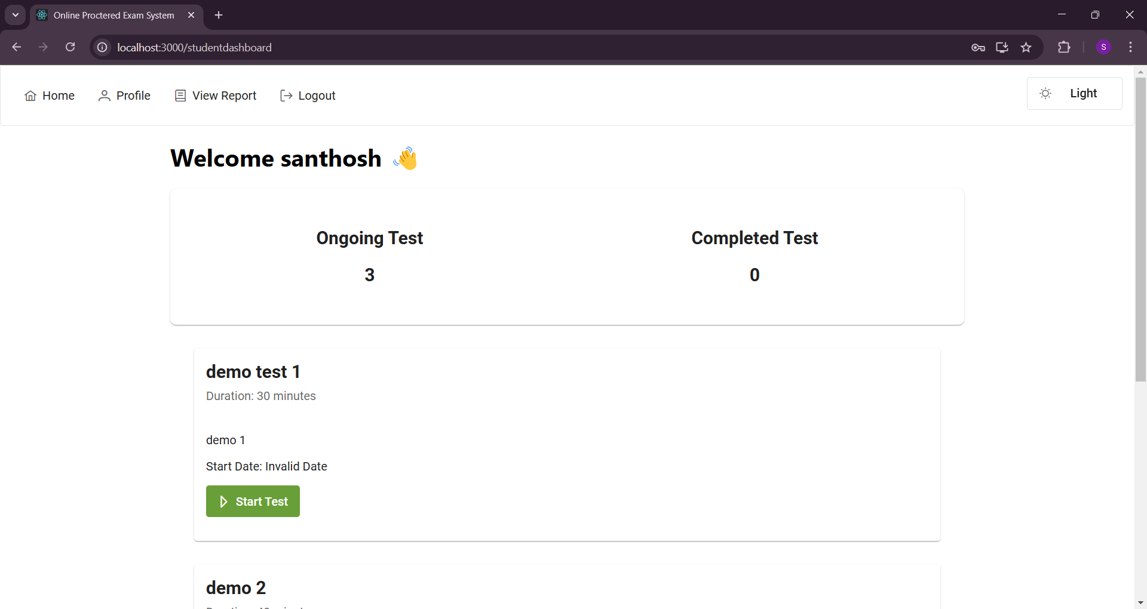
Student Dashboard

Slide 46
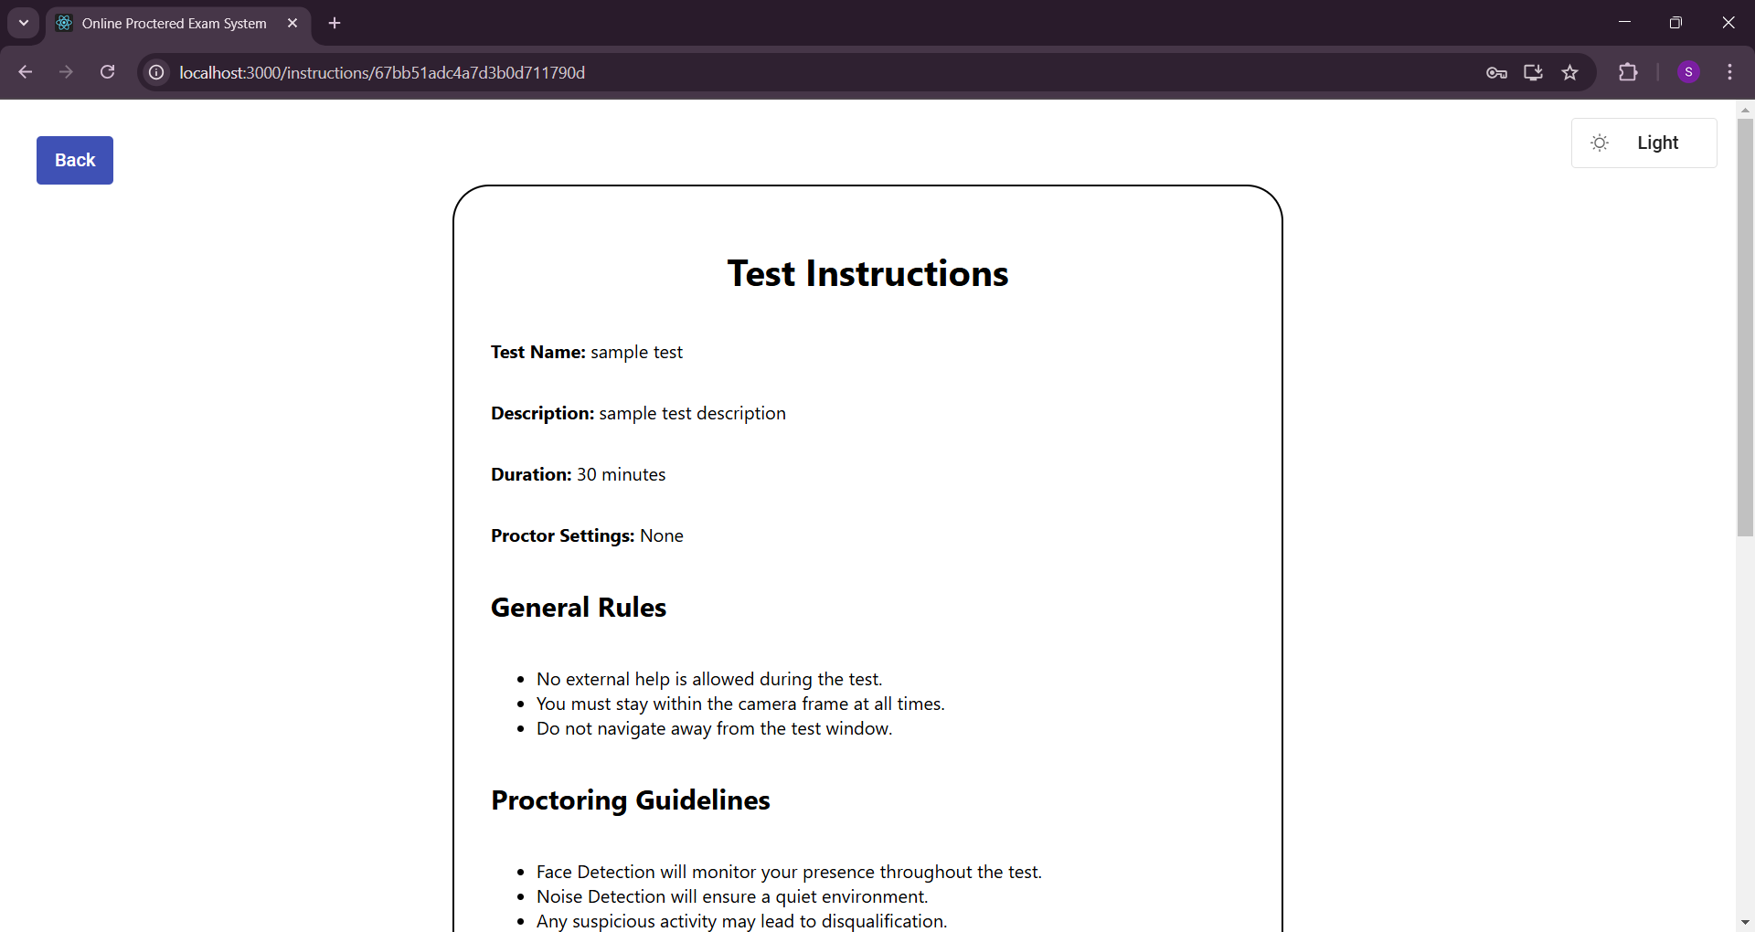
Student Test Start 1

Slide 47
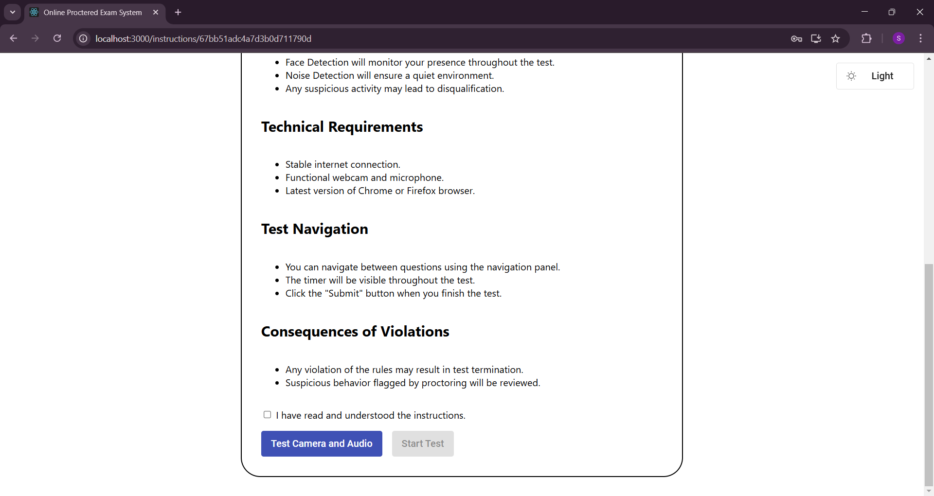
Student Test Start 2

Slide 48
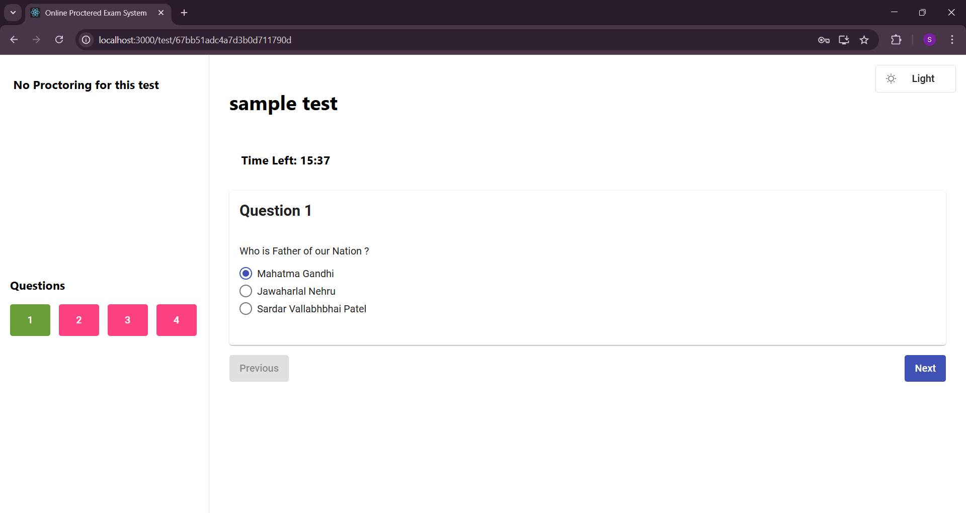
Student Test Question type 1

Slide 49
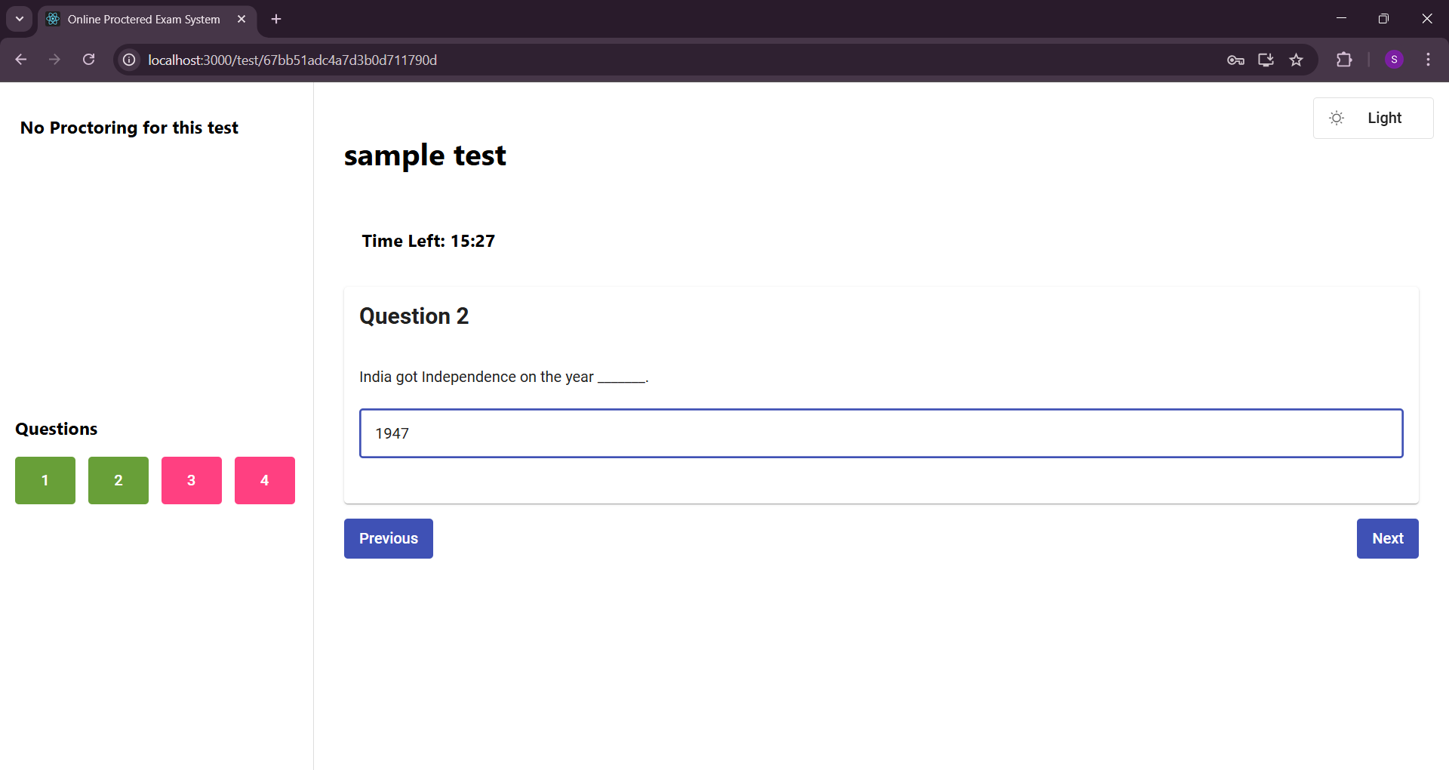
Student Test Question type 2

Slide 50
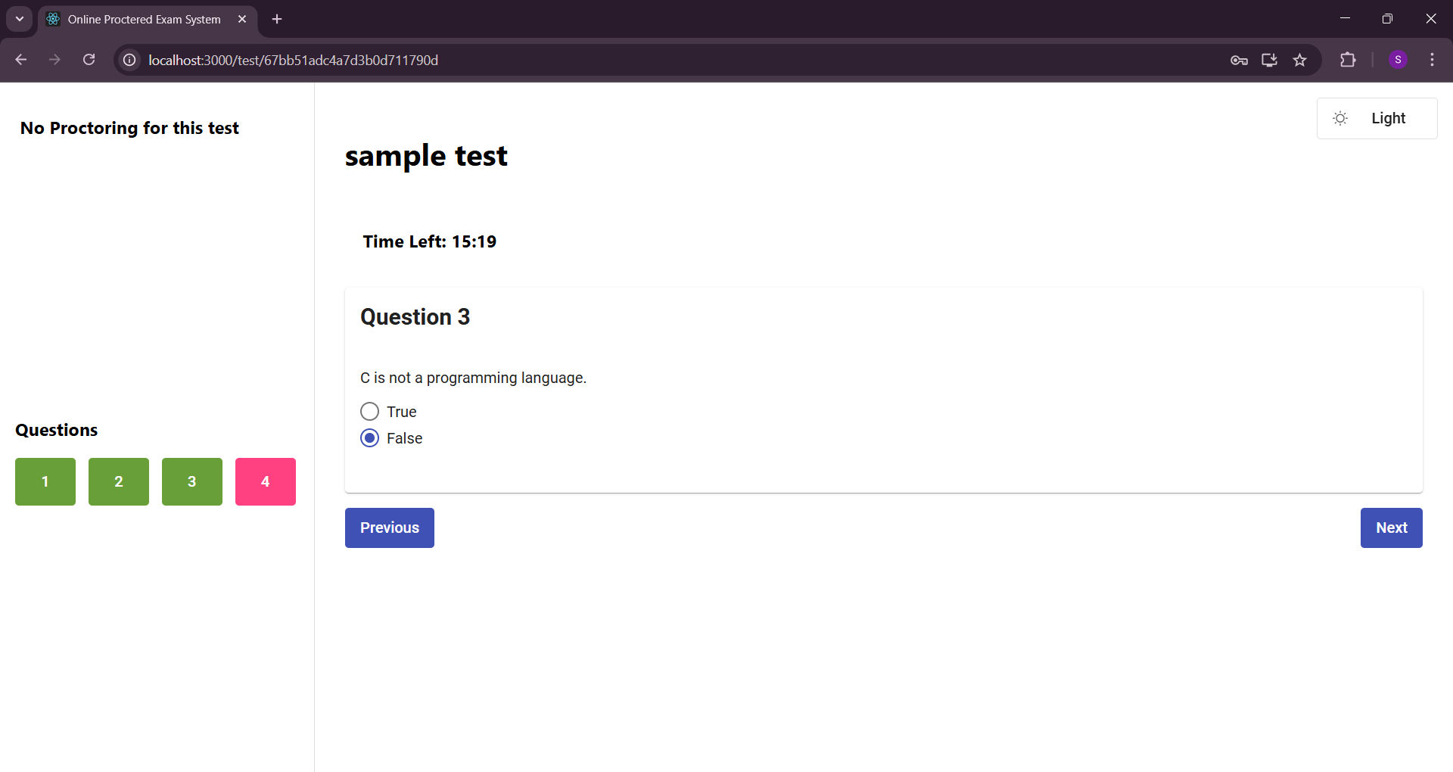
Student Test Question type 3

Slide 51
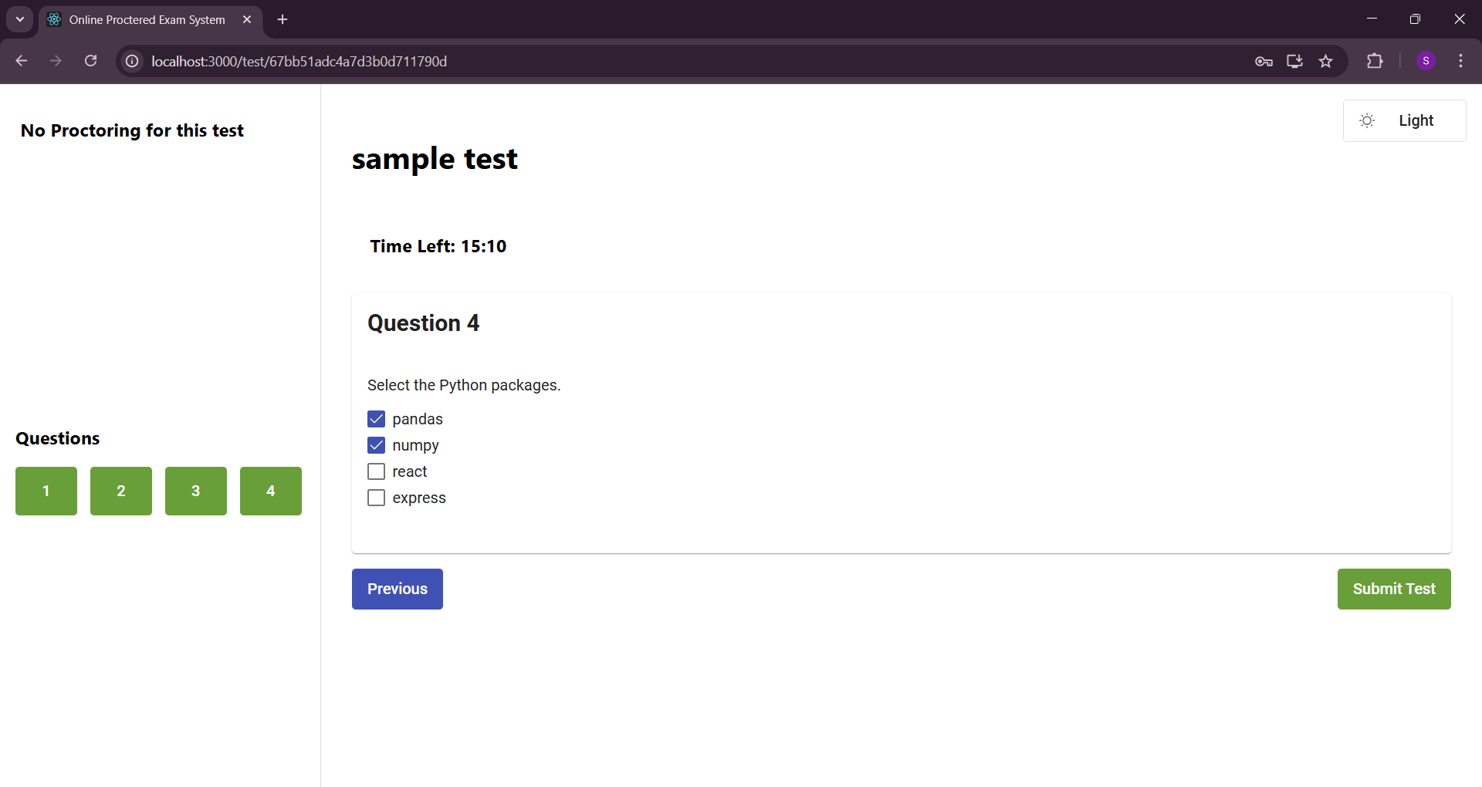
Student Test Question type 4

Slide 52
MERITS
The AI-powered proctoring system enables students to take assessments from any location, reducing the need for physical examination centers.
Teachers can create and manage online tests efficiently, streamlining the assessment process.
The system provides real-time monitoring using AI-based face detection and behavior analysis, ensuring exam integrity.
Automated result evaluation reduces the need for manual grading, saving time and effort.
The system enhances security by detecting and flagging suspicious activities, reducing the chances of cheating.

Slide 53
LIMITATIONS
The system requires a stable internet connection, which may affect users in areas with poor network coverage.
AI-based proctoring may generate false positives, leading to unnecessary flags for students exhibiting normal behavior.
The current implementation does not support real-time student-teacher interaction during the exam.
The system primarily relies on facial recognition, which may not be effective in cases where lighting conditions or camera quality is poor.

Slide 54
FUTURE ENHANCEMENTS
Enhance the AI model to improve accuracy in detecting suspicious behavior, reducing false positives.
Introduce voice detection to monitor verbal communication and prevent unauthorized assistance.
Optimize the system to function effectively even with low-bandwidth internet connections.

Slide 55
CONCLUSION
The AI-Powered Online Assessment Proctoring System is a revolutionary solution that addresses the limitations of existing assessment methods by combining advanced AI technologies with modern web development frameworks.
By eliminating the dependency on restrictive safe browsers, this system provides a seamless, secure, and user-friendly platform for conducting online exams.
Its ability to detect suspicious behaviors in real time, ensure exam integrity, and scale to meet diverse educational needs makes it a highly adaptable solution for institutions of all sizes.
Furthermore, with role-based access controls and a privacy-focused local deployment option, it ensures that both user data and system operations remain secure.

